Slide 1
UHF RCP Screens
Feb 01 2024
Final
Display “T” when PTT/TST is pressed or MN or GD when Main or Guard is received (See Note 3&7)
Main Screen at Power up
Tuned Frequency
Display Select: Frequency/ Channel / Guard (See Note 5)
Squelch ON/OFF (See Note 8)
225.00
T/GD/MN
FRQ/CH
I KHz Test Transmission On /OFF (See Note 4)
Channel Program mode selection (See Note 9)
SQ
TST
Select: Main or Both
(See Note 7)
PROG
VOL 10
MN/BOTH
Outer Dial Tune FRQ MHz / Select Channel (See Note 6)
Press PWR UP/ PWR DN (See Note 1)
Inner Dial Volume
(See Note 2)
Inner Dial Tune FRQ KHz (See Note 6)
* PTT is the press to talk button on the trainer.
Notes
Press LH knob button to power up. Press & hold for more than 3 sec to power off.. (Send ‘1’ for ON / ‘0’ for OFF on corresponding data stream byte (byte# 5).
To increase volume rotate LH inner dial clockwise. To decrease rotate counter clockwise. There are 21 volume level (0 to 20) without roll-over.
“T” is displayed when UHF radio is transmitting. (PPT or TST pressed). “T” is displayed when the ASCII “1” is sent from interface unit to RCP. See note 7 for MN/GD display function.
1.0 KHz audio tone is transmitted for 5 Sec when TST is pressed. If PTT is pressed during TST transmission TST is inhibited. (When TST is pressed the value ‘1’ on the corresponding data stream byte (byte #3) will be sent, this value must return to ‘0’ after 5 sec.)
Pressing FRQ/CH soft button will scroll through displaying Main Frequency (FRQ) and Channel No(CH).
When FRQ is selected the RH outer knob tune MHz (In steps of 1 MHz) and RH inner knob tune KHz (In steps of 25 KHz). When CH is selected the RH outer knob can be used to select a particular channel from a total of 20 preset channels.
MN/BOTH function is for receiver selection. The soft button select either MN or MN/BOTH. In Main (MN)mode the transmitting and receiving is on the displayed channel. In BOTH receiver scan on both MN and GD and locks to the either frequency. Locked frequency annunciator ( MN or GD) is displayed at the same location as “T”. Transmission in this mode is on MN frequency. (Send ‘0’ for MAIN or ‘1’ for MN/GD on corresponding data stream byte (byte # 2)).
Squelch is switch on or off by pressing “SQ” soft button. SQ is highlighted when selected. (Send ‘1’ for ON or ‘0’ for OFF on the corresponding data stream byte (byte number 4)).
Pressing the “PROG” soft button, displays the channel programming screen (shown in the next slide). In this mode a tuned frequency can be assigned to a selected channel.

Slide 2
UHF RCU Screens
Feb 01 2024
Final
Selected Channel Frequency Displayed (See Note 2)
Press soft button to select respect Channel. (See Note 1)
CHANNEL PROGRAMMING MODE SCREEM
Delete Frequency of the selected channel
(See Note 4)
225.000
CH1
Save and exit to previous screen
(See Note 3)
DELETE
CH2
Press PWR UP/ PWR DN
(See Note 6)
EXIT
CH3
Outer Dial Tune FRQ MHz in steps of 1 MHz
Outer Dial scroll Channel Pages with roll over feature
(See Note 5)
Inner Dial Tune FRQ in steps of 25 KHz
Notes
Select channel to program by press respective soft key. The selected channel will be highlighted. By default CH 1 is highlighted. Only one channel can be selected at a time.
The selected channel frequency is displayed. The frequency can be edited by using the RH inner & outer dials.
To save the edited frequency and exit to main screen press “EXIT” soft key. To return to main page in the case of the delete or no change press “EXIT”.
To delete the frequency for the selected channel press the “DELETE” soft key. When deleted “EMPTY” is displayed in place of frequency.
To scroll channel pages use the LH Outer knob. There are a total of 20 channels with 3 channels per page except the last page with only 2 channels.
To switch off while in this mode press and hold the LH knob button for more than 3 sec.
The “EMPTY” channels are inhibited to be selected

Slide 3
Feb 01 2024
Final
UHF RCP Screens
Interface
LH knob push button:
LH knob inner dial:
LH knob outer dial:
Function
After power is applied, pushing this button once to power up the RPC, the display turns on showing the start up screen. Also at the same time, send the “Turn On” message with the saved state (the last settings before turn off) to the interface. To turn off power, press this button for more than 3 sec. Tuned frequency and channel frequencies are saved, a turn off message (ASCII ”$00000000000000<CR><LF>”) is sent to the interface and the screen is turned “OFF”
This knob is used to increase and decrease volume. Turn clockwise(CW) to increase & counter clock wise (CCW) to decrease. Increase / decrease in volume is shown as a number between 0 and 20. The volume function does not work in channel program mode.
The LH outer dial is used in the channel program mode for selecting channels. The default channel selection is CH 1 and its frequency is displayed on the top LH side line. The selected channel has a highlighted background. Rotate this knob CW to scroll down & CCW to go to scroll up.

Slide 4
Feb 01 2024
Final
UHF RCP Screens
Interface
Function
RH knob push button:
RH knob inner dial:
RH knob outer dial:
No function
Tunes the KHz part of the frequency for both “FRQ “ and “ CH”. The KHz part of the displayed frequency is changed in steps of 0.025 MHz. This knob does not function in “GD” mode as a fixed guard frequency 243.000 MHz is used.
Tunes the MHz part of the frequency for both “FRQ “ and “ CH”. The MHz part of the frequency is changed in steps of 1.0 MHz. This knob does not function in “GD” mode as a fixed guard frequency is used.

Slide 5
Feb 01 2024
Final
UHF RCP Screens
Interface
Function
LH top soft button:
LH middle soft button:
LH bottom soft button:
No function
In the main screen “SQ” is displayed against this button. This button is used to toggle between the squelch on and squelch off function. When squelch is on the SQ back ground is highlighted.
In the channel program mode “DELETE“ is displayed against this button. Pressing this button will delete the frequency against the selected channel and will display “EMPTY” in its place.
On the main screen PROG is displayed against this button. This button is used to switch to the channel program mode.
In the channel program mode “EXIT” is displayed against this button. When pressed the display reverts back to the previous main screen and the changes in the channel frequencies is saved.

Slide 6
Feb 01 2024
Final
UHF RCP Screens
Interface
Function
RH top soft button:
RH middle soft button:
On the main screen “FRQ/CH” is displayed against this button. This button is used to display the Main Frequency or the Channel No . The selected option is highlighted. The top LH display line shows the frequency when FRQ is selected and show Channel No when CH is selected.
In the Channel Program Mode the channel displayed against this button is selected. The selected channel is highlighted.
On the main screen “TST” is displayed against this button. This button is used to transmit a 1 Khz audio signal for a duration of 5.0 sec. When the button is pressed the “TST” is highlighted, and after 5.0 sec it is turned off. The 1 KHz test tone is inhabited when PTT is pressed.
In the channel program mode the channel displayed against this button is selected. The selected channel is highlighted. The TST is Disabled (unavailable) in the BOTH receiver mode.

Slide 7
Feb 01 2024
Final
UHF RCP Screens
Interface
Function
RH bottom soft button:
On the main screen “MN/BOTH” is displayed against this button. In Main (MN)mode the the UHF R/T transmits and receives on the displayed (active) frequency / channel. In the MN/BOTH mode the receiver scan on for main and guard transmission and locks to the either frequency. The annunciator associated with the locked frequency is displayed. Transmission in this mode is on active frequency
In the channel program mode the channel displayed against this button is selected. The selected channel is highlighted.

Slide 8
Feb 01 2024
Final
UHF RCP Screens
Notes:
The frequency range is between 225.000 and 399.975 MHz with 25 KHz steps.
The TST is Disabled (unavailable) in the BOTH receiver mode.
The data stream between the RCP and the interface is described in the next slides.
Implement roll-over and roll-down for frequencies and channels in all modes.
If any of the 20 channels are not programmed in the programming mode, do not display them in the preset mode.
Some instructions may be updated in the future.

Slide 9
Feb 01 2024
Final
UHF RCP Interface Communication
Baud Rate = 9600
RCP Interface Data Format: $MMMKKKVVOSTDCC<CR><LF>
14 13 11 10 8 7 6 5 4 3 2 1 0
1-
Byte
3-Byte
3-Byte
2-Byte
1-Byte
1-Byte
1-Byte
1-Byte
2-Byte
Byte 14: Start byte. Always ‘$’.
Byte 13 – 11: “MMM” 3-Byte. The corresponding three ASCII codes of the MHz frequency value (range from225 to 339). For tuning the MHz part of frequency.
Byte 10 – 8: “KKK” 3-Byte. The corresponding three ASCII Codes of the KHz frequency value (range from 000 to 975). For tuning the KHz part of frequency.
Byte 7 – 6: “VV” 2-Byte. The Volume Control value. We have 21 – level 0- 20 (See next page for the map ASCII values). For adjusting volume.
Byte 5: “O” 1-Byte. The Power ON/OFF byte. In ASCII (1 = ON or 0 = OFF). For power up and power down for the R/T and RCP.
Byte 4: “S” 1-Byte. The Squelch state byte. In ASCII (1 = ON or 0 = OFF). Switch squelch on and oFF.
Byte 3: “T” 1-Byte. The 1 KHz audio Test Tone byte. In ASCII (1 = ON or 0 = OFF). Switch on test transmission with 1Khz audio tone.
Byte 2: “D” 1-Byte. The Receiver Mode byte. In ASCII (0 = MAIN or 1 = BOTH). Sets receiver mode either, Main (Tuned) or both Main and Guard frequency.
Byte 1-0: “CC” 2-Byte. They are the Check Sum Bytes. Following the same mechanism of the SL30.

Slide 10
Final
UHF RCP Interface Data Format
Volume Control Mapping:
Volume Level | Send ASCII
0 | 00
1 | 01
2 | 04
3 | 07
4 | 12
5 | 17
6 | 22
7 | 27
8 | 32
9 | 37
10 | 42
11 | 47
12 | 52
13 | 57
14 | 62
15 | 67
16 | 72
17 | 77
18 | 82
19 | 87
20 | 99

Slide 11
Final
UHF RCP Interface Data Format
Interface RCP Data Format : $TPGCC<CR><LF>
“$” The Start byte it is always ‘$’.
*“T” The Transmit byte. In ASCII (1 = ON or 0 = OFF). This is used to display “T” when the transmitter is “ON”.
**“P” The received Signal Present byte. In ASCII (1 = ON or 0 = OFF). This byte is“1” when a valid signal is received by the R/T.
**“G” The Guard frequency received byte. In ASCII (1= Guard or 0 = Main).This byte is “1” when Guard frequency is received by the R/T.
“C” is the Check Sum byte. Following the same mechanism of the SL30.
Baud Rate 9600
5 4 3 2 1 0
1-
Byte
1-Byte
1-Byte
1-Byte
2-Byte
* Note: When the transmitter is keyed by either by pressing the “PPT” button or by pressing the “TST” button then a data word is sent from the Interface unit to the RCP. ASCII word “1” is sent when the PPT / TST is pressed. And ASCII word “0” is sent when the PPT is released or in case of the TST the 5 sec timer is out.
** Note: See the next slide for truth table for displaying “MN” and “GD”.

Slide 12
Truth table for display MN or GD
Mode P G Display
MAIN (0) 0 X N/A
MAIN (0) 1 X MN
BOTH (1) 0 X N/A
BOTH (1) 1 0 MN
BOTH (1) 1 1 GD
**Note: The MN/BOTH selection will be read from the RCP along with bytes “P” &”G” coming from the interface unit to display either MN or GD. See truth table above.

Slide 13
Common Interface Requirements for RCP to CDU Communication
When interfacing the RCP with the CDU, implementation of following functions is mandatory.
At power up the RCP will do the following
Power up the radio connected to the RCP.
Synchronize the frequency information: The active and standby frequency and / or channel information is to be update on the CDU by the RCP. The desired result is that both RCP and CDU should show same frequency/channel information at RCP power up.
Synchronize the volume information: The volume level that is set on the RCP must be shown on the CDU.
Preset channels frequencies must be the same on both the CDU and RCP. When a channel is programmed from the CDU or RCP the programmed frequency must be the same both units.
Both the RCP and the CDU should be able to tune the NAV/COMM radio.
The RCP should be able to tune the attached radio even when CDU is not switched on.
The CDU can only tune the selected radio when RCP is switch on and connected to the radio.
At power off the RCP should do the following
Save last setting for both frequency and volume.
Turn of the attached radio
Switch of it self.

Slide 14
Trainer Data Bus Block Diagram
UHF RCP
UHF interface
UHF RT
CAN BUS
RS323
K Serial
CDU
CAN BUS
VHF RCP
VHF RT
CAN BUS
CAN BUS
RS323
HF Interface
K Serial
HF RT
CAN BUS
HF RCP
RS323

Slide 15
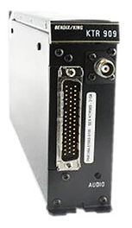
RCP to UHF RT Communication
The UHF RCP interfaces to the UHF R/T through an interface unit as shown below:-
Interface Unit
225.000
CH1
DELETE
CH2
RS323 Communication
King Serial Interface
EXIT
CH3
Note: RCP to Interface unit the communication protocol is RS 232 serial communication.
Interface unit to the UHF RT the communication is on King Serial.

Slide 16
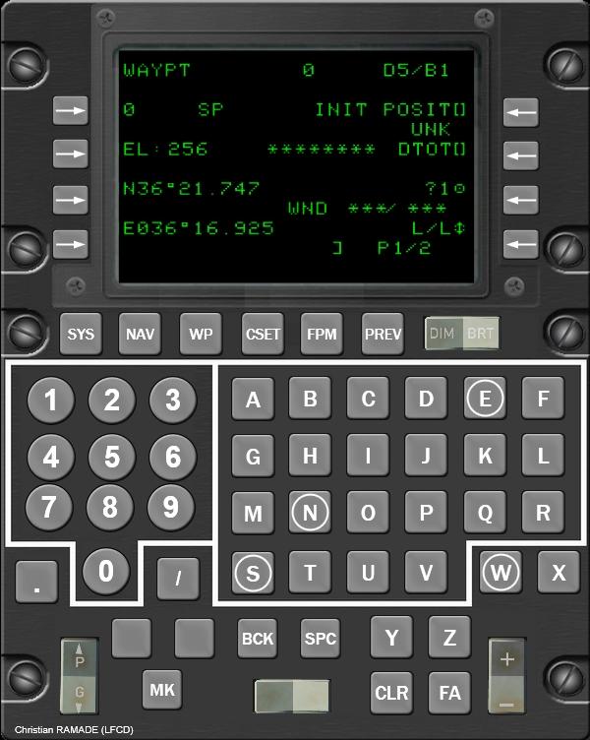
RCP to CDU Communication
225.000
CH1
DELETE
CH2
CAN BUS
EXIT
CH3
Note: The CAN bus connects the CDU to the following:-
1, UHF RCP
2, VHF RCP
3, HF RCP

